Slide 1



Design and Performance Analysis of Pharmacy Information Systems
SANDHIYA . M
CSE - C (III Year)
211422104424

Slide 2



ABSTRACT
This project introduces an innovative Online Pharmacy Web Application utilizing cloud-based DES (Data Encryption Standard) and ciphertext algorithms. The system caters to three main user roles: admin, customer, and user, each equipped with unique login capabilities.
The core objective is to establish a secure and efficient platform for purchasing pharmaceutical products over the internet.
Key features include robust encryption techniques implemented through DES to ensure the confidentiality and integrity of sensitive data, such as customer information and transaction records.
By leveraging cloud technology, the application achieves scalability and accessibility, accommodating diverse operational needs and user requirements.

Slide 3


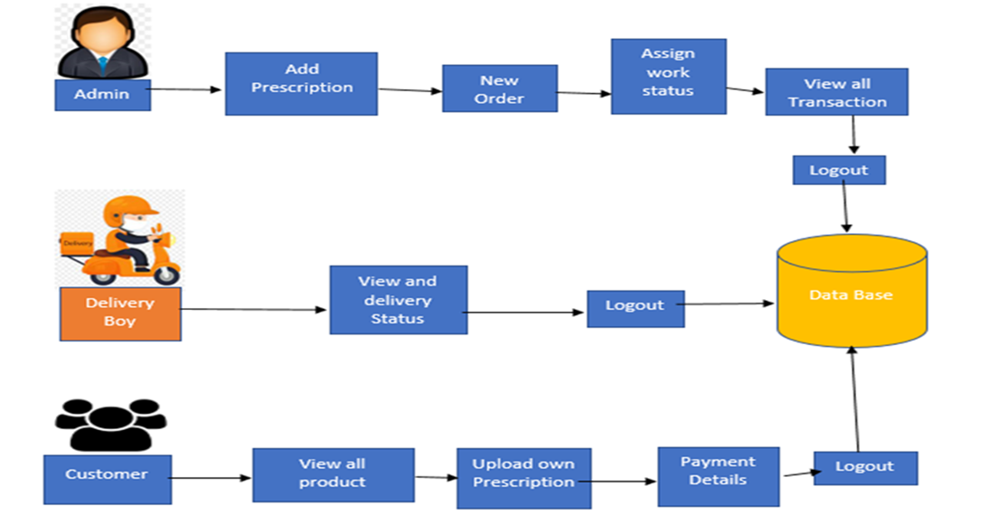
ARCHITECTURE DIAGRAM

Slide 4
PROBLEM STATEMENT
Traditional pharmacy systems often rely on manual processes for managing prescriptions and handling orders, which can lead to inefficiencies, long wait times, and errors in medication fulfillment. Patients are required to visit pharmacies in person to place orders, making the process inconvenient, especially for those with mobility or health challenges. Additionally, basic inventory management systems can result in medication shortages and delays. The absence of real-time order tracking and limited communication between patients and pharmacy staff further contribute to an unsatisfactory patient experience.

Slide 5
EXISTING METHODS
1. Manual Prescription Processing: Pharmacies often rely on manual input for processing prescriptions. Patients visit in person, and the staff manually enters prescription details into their system
2. In-Person Medication Ordering: Patients typically need to be physically present at the pharmacy to place their orders, leading to long wait times, inconvenience for those with mobility issues, and a lack of flexibility for chronic patients who need regular refills.
3. Basic Inventory Management: Inventory is usually tracked manually or through simple digital systems, which often do not provide real-time data. This can lead to stock shortages or overstocking

Slide 6
PROPOSED WORK
The proposed work involves the development and implementation of a Pharmacy Information System (PIS) designed to enhance the efficiency and effectiveness of pharmacy operations. The key features of the system include: 1. Online Prescription Upload: Patients can securely log in and upload their prescriptions through the web application, eliminating the need for in-person visits.
2. Medication Ordering: The system allows patients to place medication orders online, reducing wait times and improving accessibility.
3. Real-Time Order Tracking: Patients can track the status of their orders in real?time, providing transparency and reducing uncertainty about when medications will be ready.
4. Automated Inventory Management: The system will integrate an automated inventory management feature to ensure accurate stock levels and timely restocking of medications.

Slide 7
HARDWARE REQUIREMENTS
• System: Dual core
• Hard Disk: 500 GB
• RAM: 8 GB • Monitor: 15" VGA Colour
• Mouse: Logitech
• Network: High-speed router (10 Mbps minimum)
SOFTWARE REQUIREMENTS
• Operating System: Windows 10/11, Linux (Ubuntu), or macOS
• Database: MySQL, PostgreSQL, or MongoDB
• Development Environment: NetBeans
• Database Management: SQLyog
• Programming Languages: HTML, CSS, JavaScript, and a server-side language
• Frameworks: React, Angular, or Vue.js for front end; Node.js or Django for
• Software: Antivirus and firewall protection

Slide 8
ADMIN SENSOR MODULE
• Login: Admin can log in using the correct username and password.
• Add Prescription: Add product details along with their costs.
• View and Update: View all updated products categorized; options to delete or edit products.
• Add Delivery Boy: Add new delivery boys with their basic information.
• New Order: View all new orders, update product costs, and assign work to delivery boys.
• Assign Work Status: Monitor and update the status of delivery tasks for delivery boys.
• View All Transactions: View all delivered products and related transactions.
• Logout: Admin can log out of the system.

Slide 9
CUSTOMER SENSOR MODULE
• Registration: Customers can register an account with basic information.
• Login: Customers can log in with the correct username and password.
• View Products: View all available products and place orders.
• Upload Prescription: Upload prescriptions in image format for ordered products.
• Payment Details: View all orders and cost updates.
• Logout: Customers can log out of their accounts.

Slide 10
Cloud Server Model
The Cloud Server Module facilitates the overall functionality and data management of the Pharmacy Information System.
• Data Storage: Securely stores user information, product details, prescriptions, and transaction data in the cloud.
• User Authentication: Manages login sessions for admin, customers, and delivery boys, ensuring secure access to the system.
• Real-Time Updates: Provides real-time data synchronization across all user interfaces, ensuring that all users have access to the latest information.
• Scalability: Easily scales resources based on user demand and system load, ensuring optimal performance.
• API Integration: Supports integration with external services for payment processing and other functionalities, enhancing system capabilities.
• Performance Monitoring: Monitors server performance and user activity to optimize resource allocation and improve response times.

Slide 11
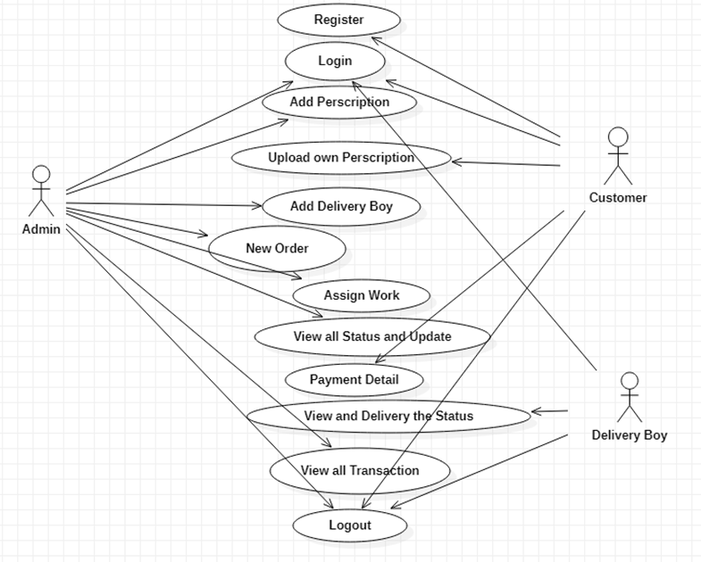
USE CASE DIADRAM

Slide 12
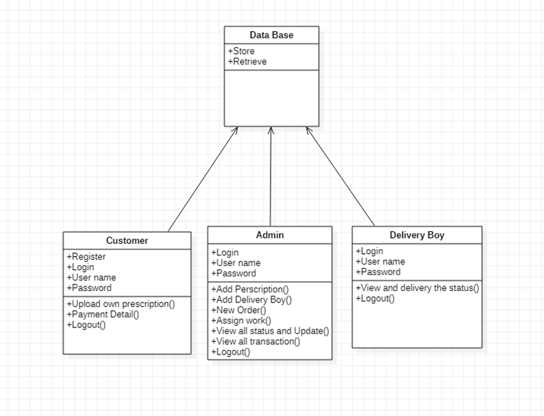
CLASS DIAGRAM

Slide 13
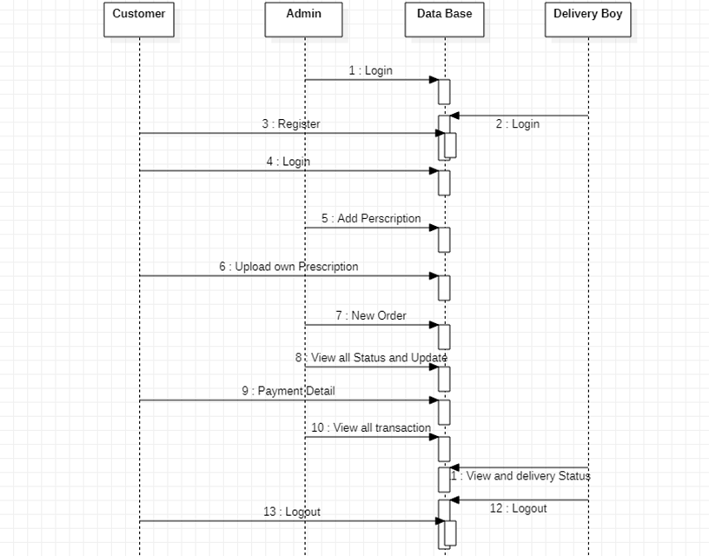
SEQUENCE DIAGRAM

Slide 14
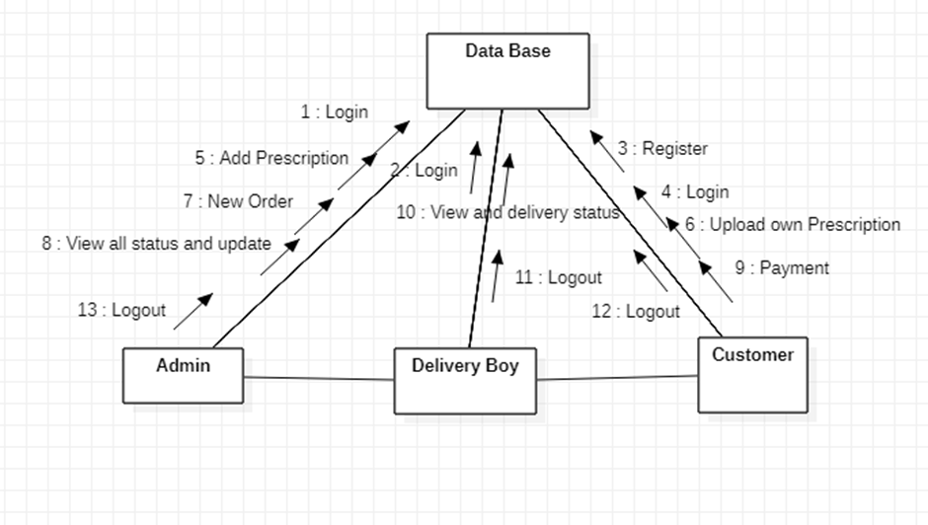
COMMUNICATION DIAGRAM

Slide 15
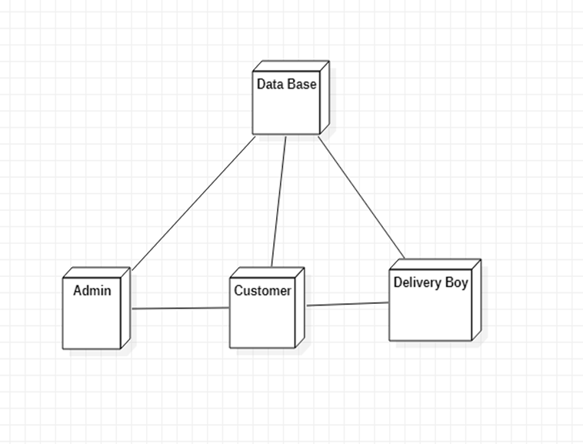
DEPLOYMENT DIAGRAM

Slide 16
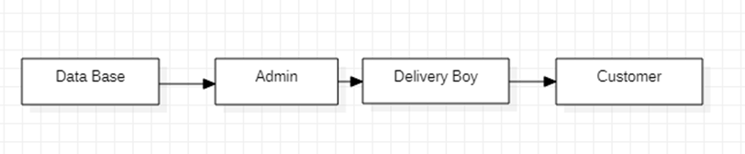
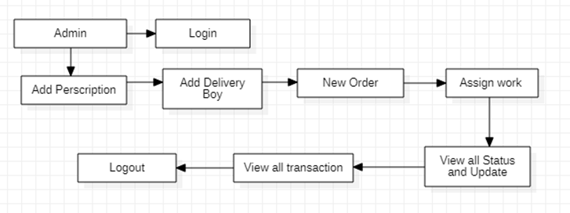
DATA FLOW DIAGRAM
LEVEL 0 :
LEVEL 1 :

Slide 17
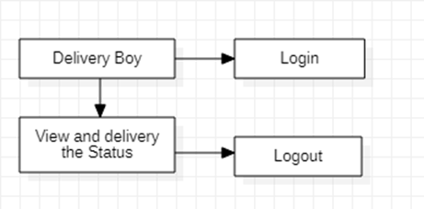
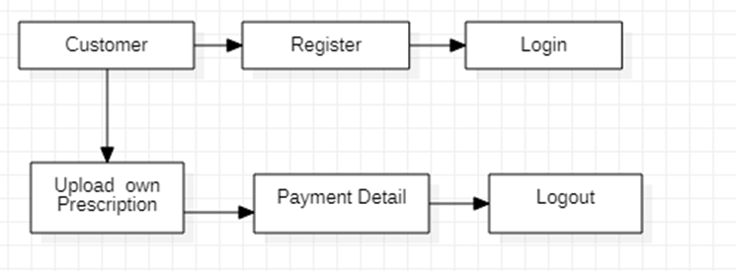
LEVEL 2 :
LEVEL 3 :

Slide 18

CONSULTANCY PROJECT
KUMARAN MEDICALS
ADDRESS:
No 18 D/2, Pattalla Street, Little Kanchipuram, Kanchipuram - 631501
CONTACT :
07947120404

Slide 19
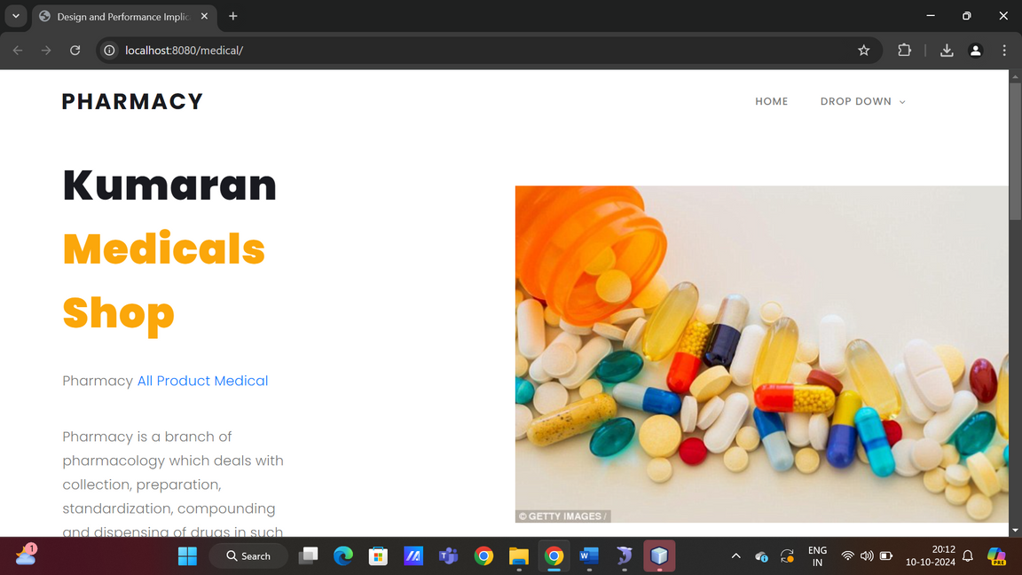
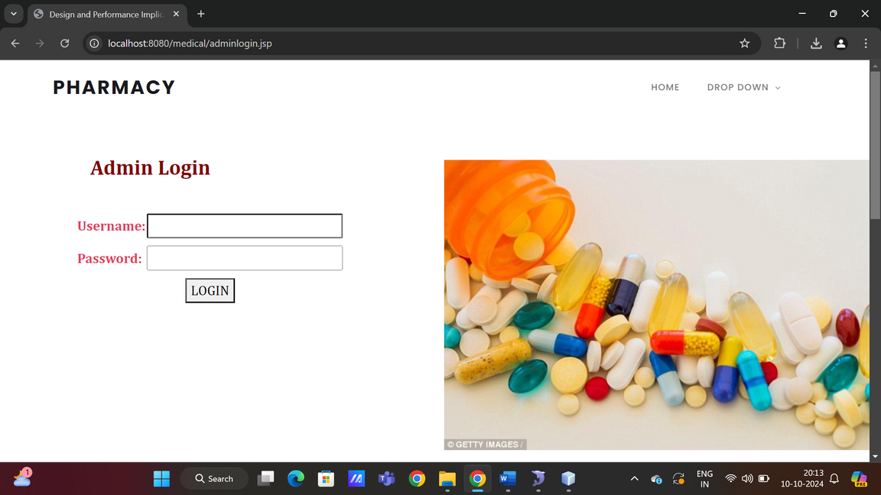
USER INTERFACE
FRONT PAGE AND ADMIN LOGIN

Slide 20
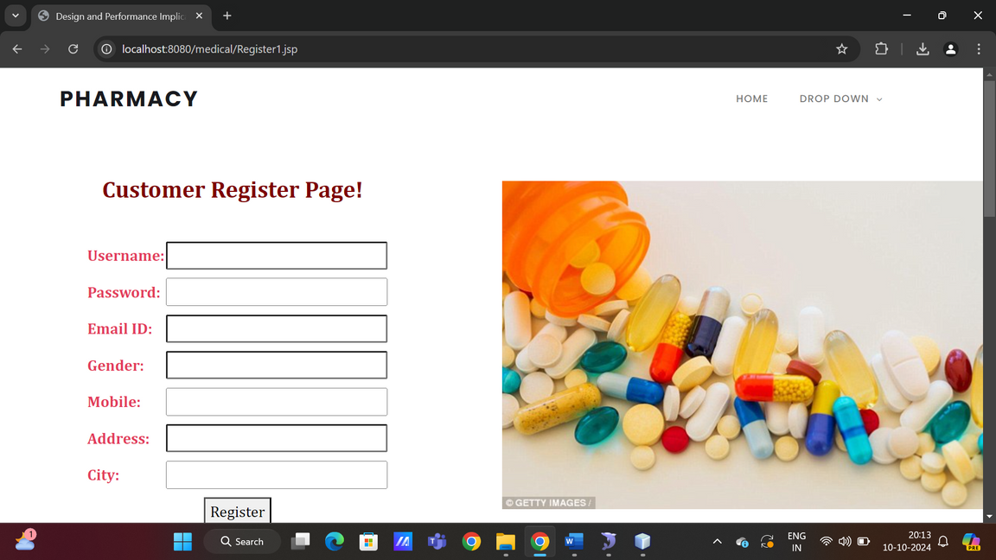
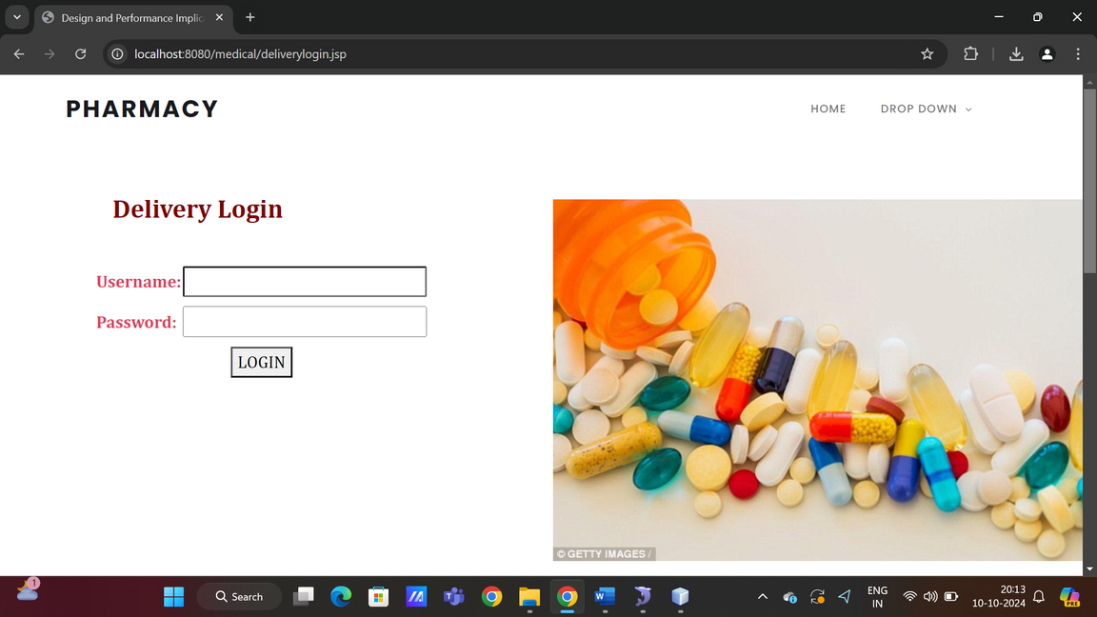
CUSTOMER REGISTRATION PAGE
DELIVERY LOGIN PAGE

Slide 21
CONCLUSION
The pharmacy management system plays a pivotal role in transforming the way pharmacies operate in a digital world. By integrating core functionalities like customer order management, prescription uploads, real-time delivery tracking, and administrative control, the system addresses key challenges faced by traditional pharmacies. One of the most significant contributions is the streamlining of the medicine ordering process, which enhances convenience for customers who can now upload prescriptions, track their orders, and make secure payments, all through a web-based platform. From a performance standpoint, the system is built to handle a variety of user roles— admin, customers, and delivery personnel—each with distinct tasks. To ensure a smooth experience for all users, the system incorporates asynchronous operations, effective database management, and scalability features. This allows for quick processing of user requests, even under heavy workloads. The use of CDNs for large file uploads, optimized database queries, and caching of frequently accessed data ensure that the system can handle high traffic without compromising performance.

